Slide 1
Report 05/14/2020
P. Hacker

Slide 2
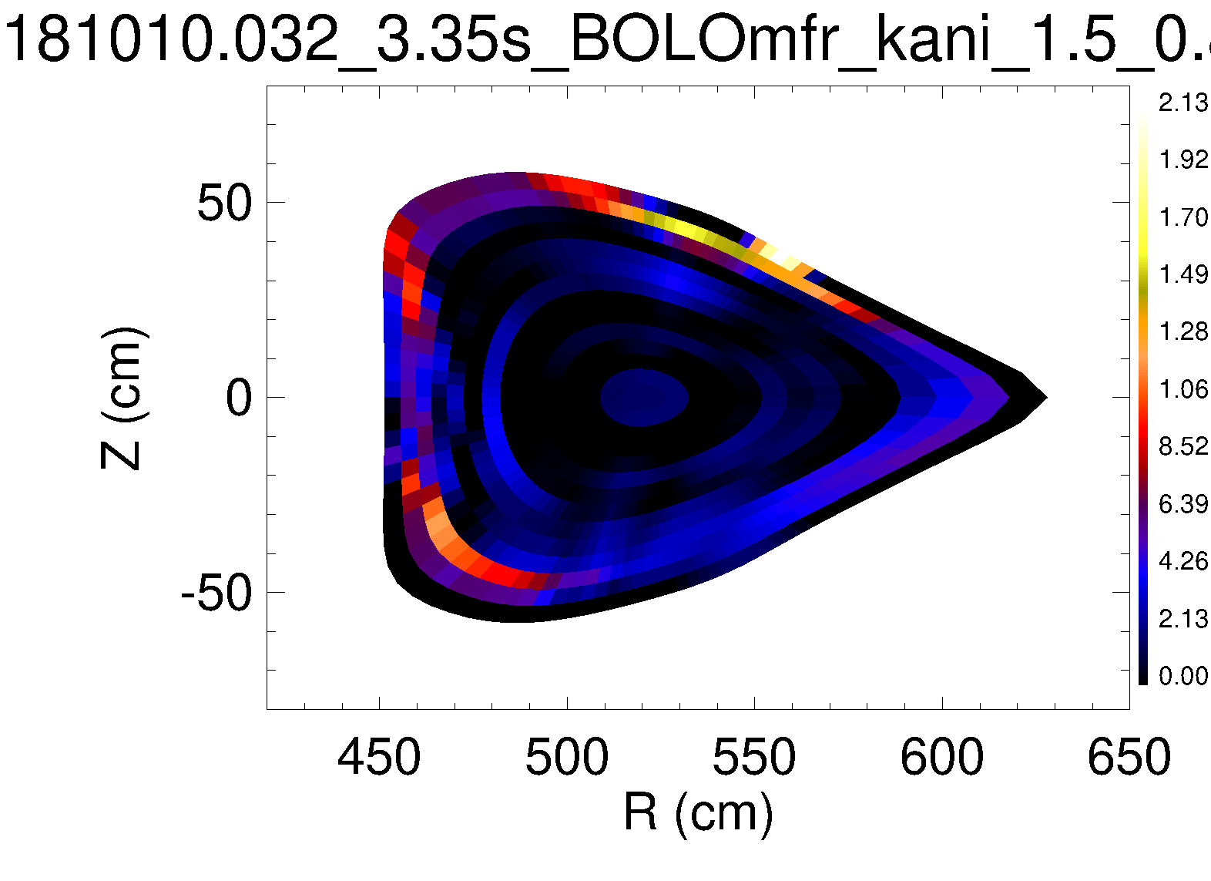
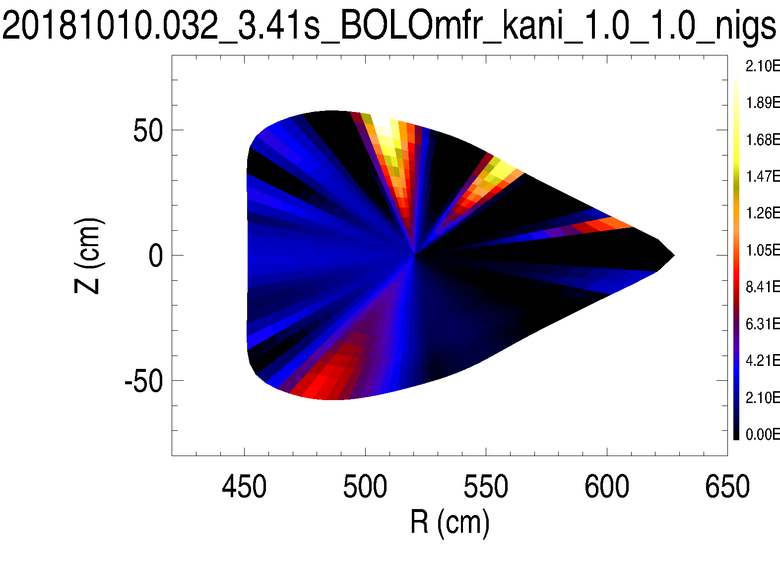
Previously: 2D Tomography - First Results
t = 3.421s <-> frad=100%
anisotropy factors – poloidal smoothing, i.e. gradient restrictions, set to 1.5 inside the LCFS and 1.2 at the edge
anisotropy factors set to 1.0 and 1.0

Slide 3
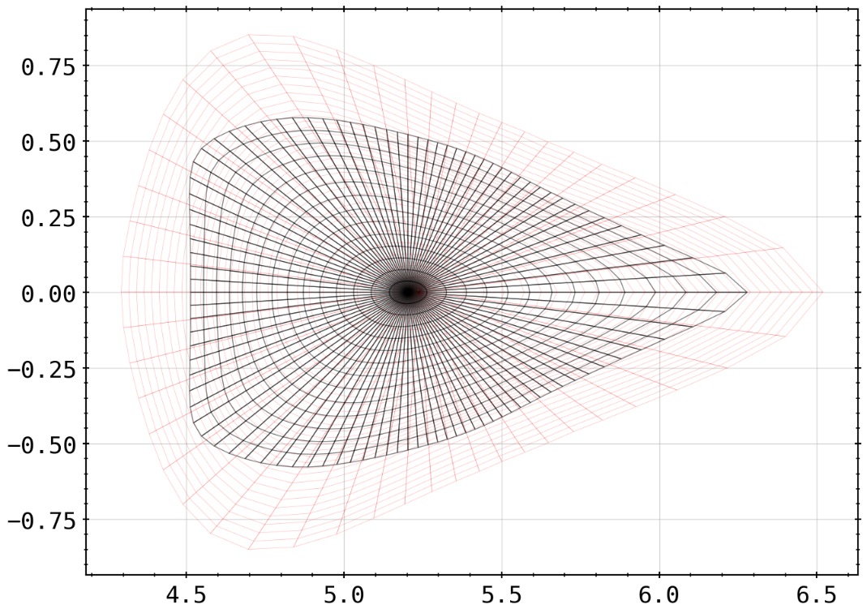
Previously: 2D Tomography - First Results
next step: set up forward calculation of chordal brightness profile from the 2D results of tomography as shown before
change geometry of mesh to represent more vessel (plasma) volume

Slide 4
Previously: Agenda
Not in order:
start to finish RSI paper (for internal reviewing)
understand anisotropy factor, hence structure of tomogram
create and feed phantom radiation profiles to inversion method using that knowledge

Slide 5
Agenda
calculating chordal profiles based off of geometry data used also for reconstruction
iterating through frad = 33%, 66%, 90% and 100% for comparison
set up forward calculation of chordal/radial brightness profile from the results of tomography
change mesh geometry to check for intrinsic geometry of approach

Slide 6
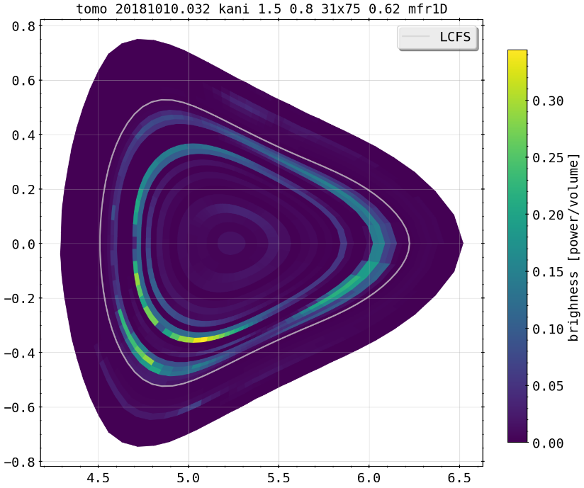
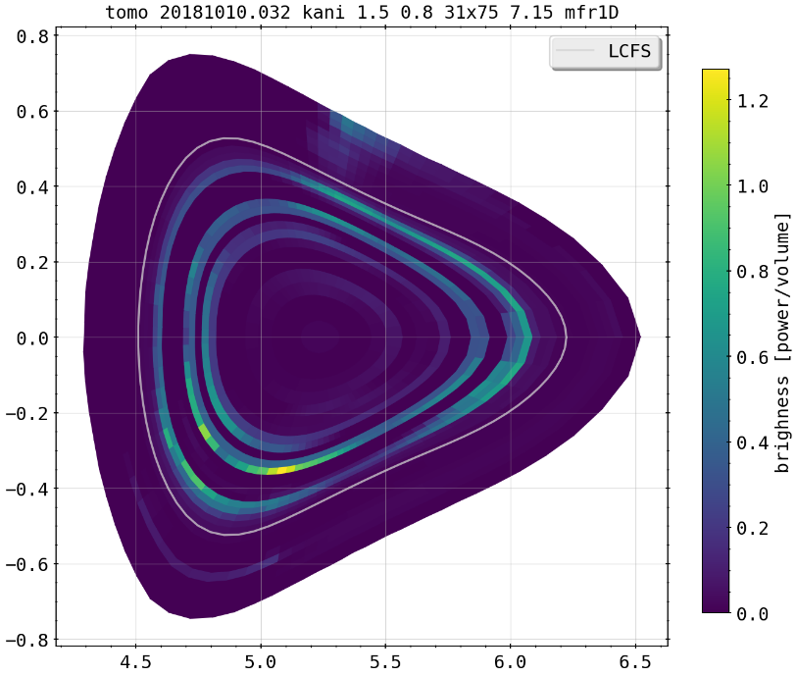
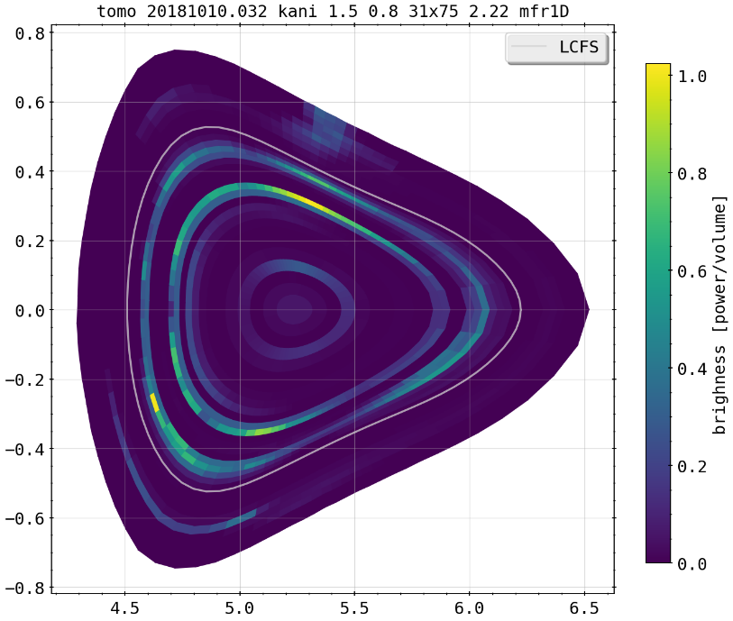
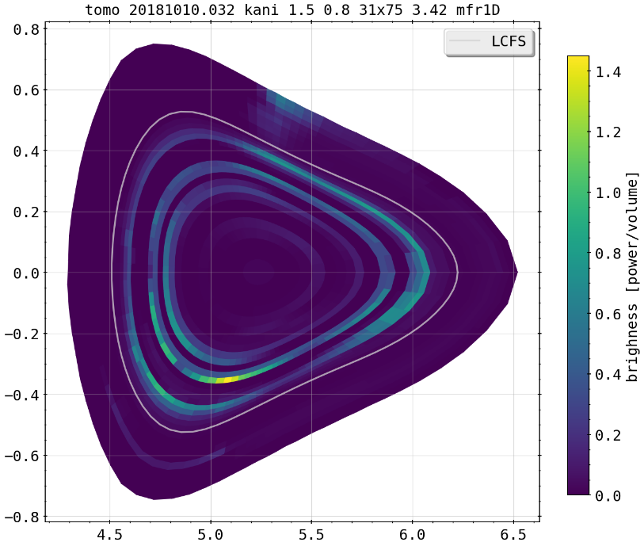
Selfconsistent Tomography for 20181010.032
prime feedback controlled discharge as test to see whether radiation moving from beyond the LCFS to inside is resolvable by algorithm
same configuration and anisotropy factors for all calculations
increasing brightness level, artifacts on last cell sheath for compensation?
frad=33%
frad=90%
frad=66%
frad=100%

Slide 7
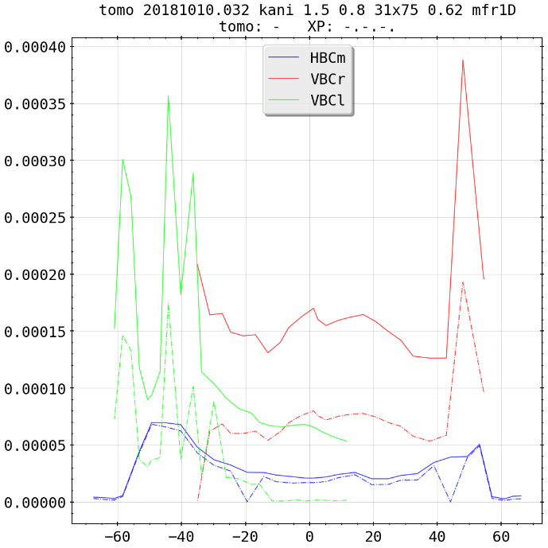
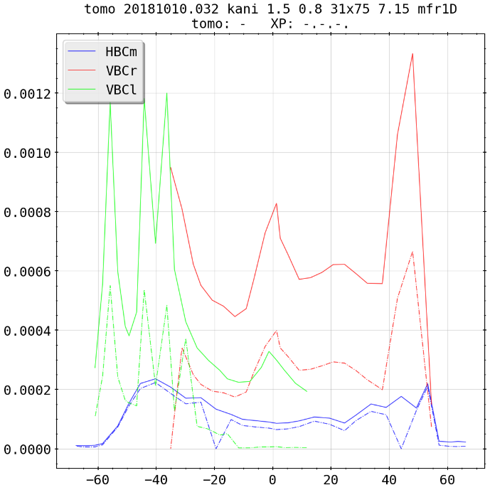
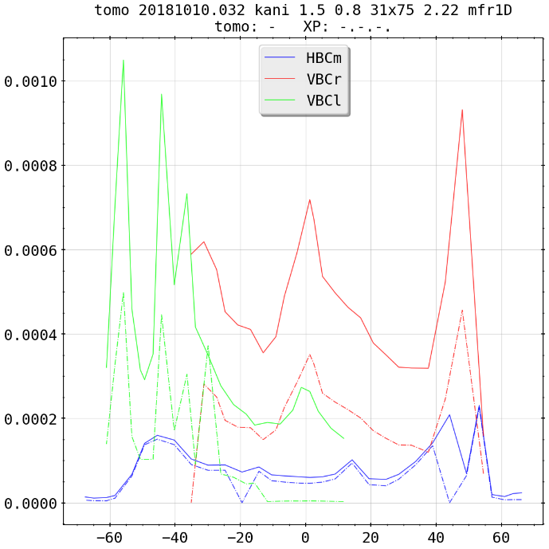
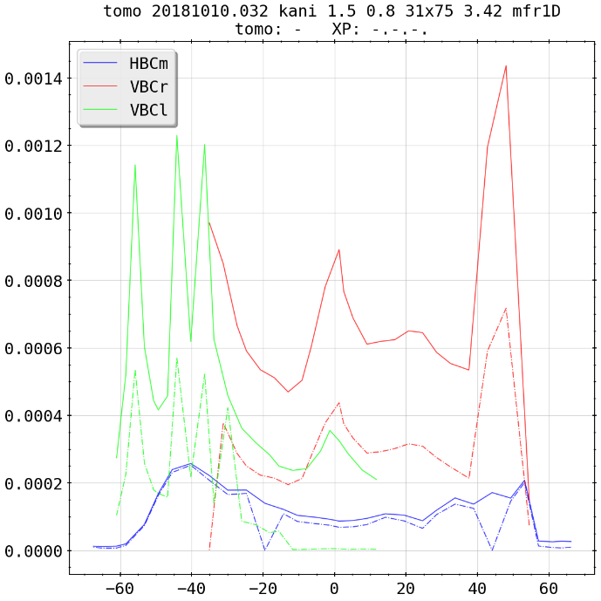
Selfconsistent Tomography for 20181010.032
frad=90%
same discharge, but forward and backwards calculated chordal profiles for camera arrays
in general Χ²~1.0, fit for HBCm pretty good, less so for vertical cameras (see D.Zhang et al.)
‘eratic’ chordal profiles almost impossible to represent with poloidal smoothness and constraints
frad=33%
frad=100%
frad=66%

Slide 8
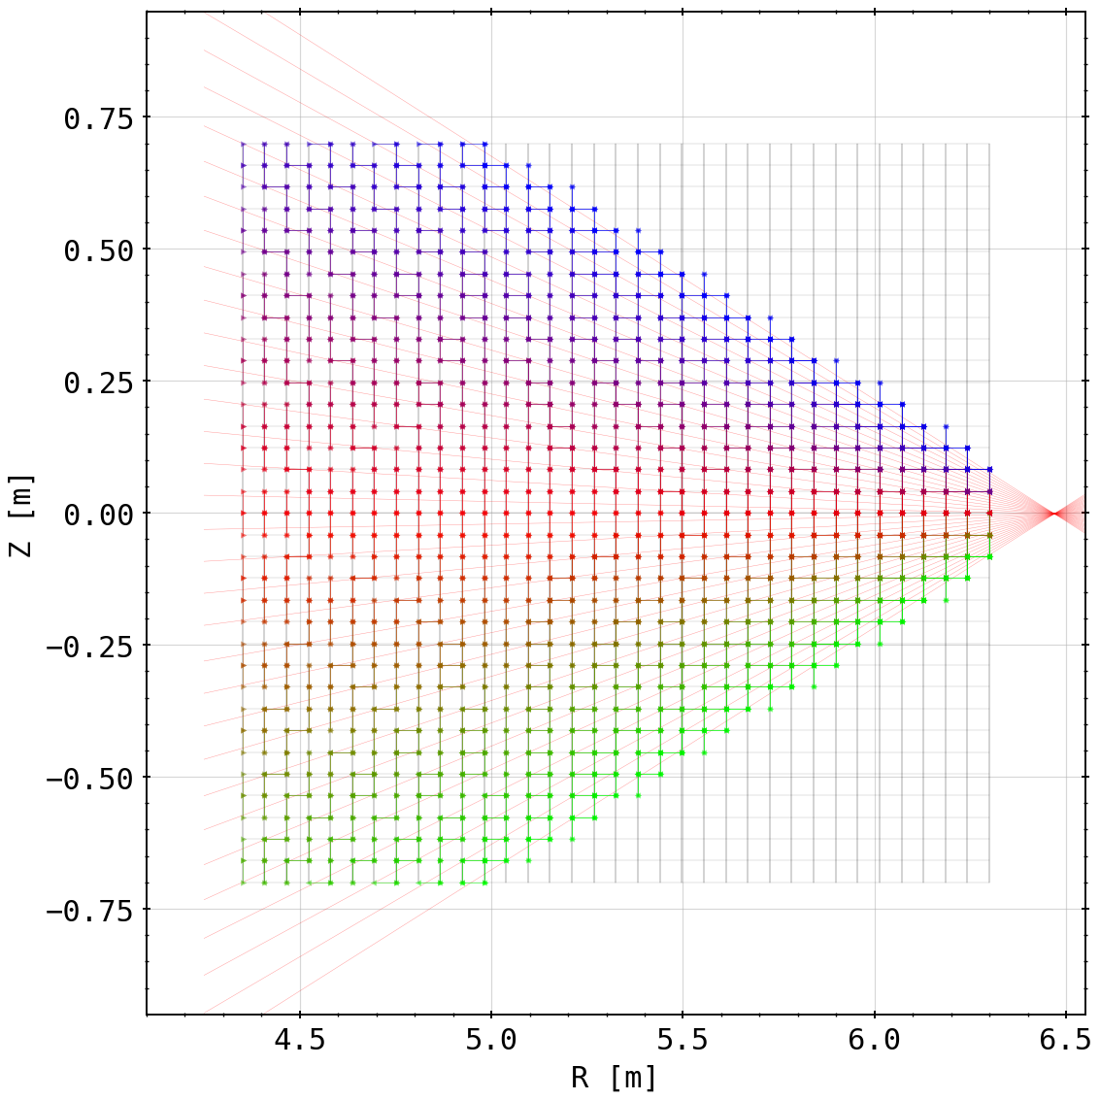
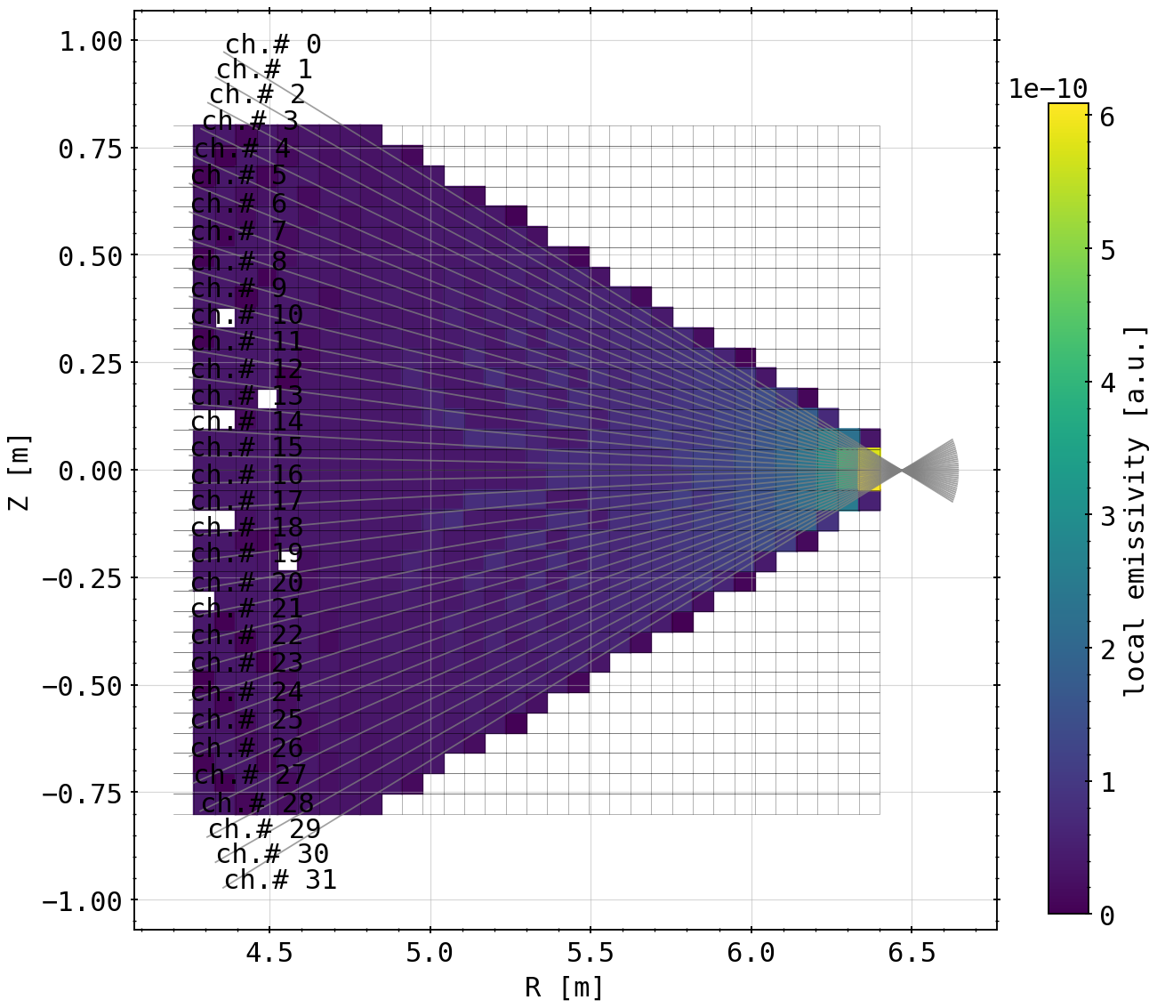
Cartesian Mesh and Test
using simple cartesian, i.e. rectangular mesh instead of fluxsurfaces and poloidal lines to calculate the geometry and tomogram
35x35
35x35

Slide 9
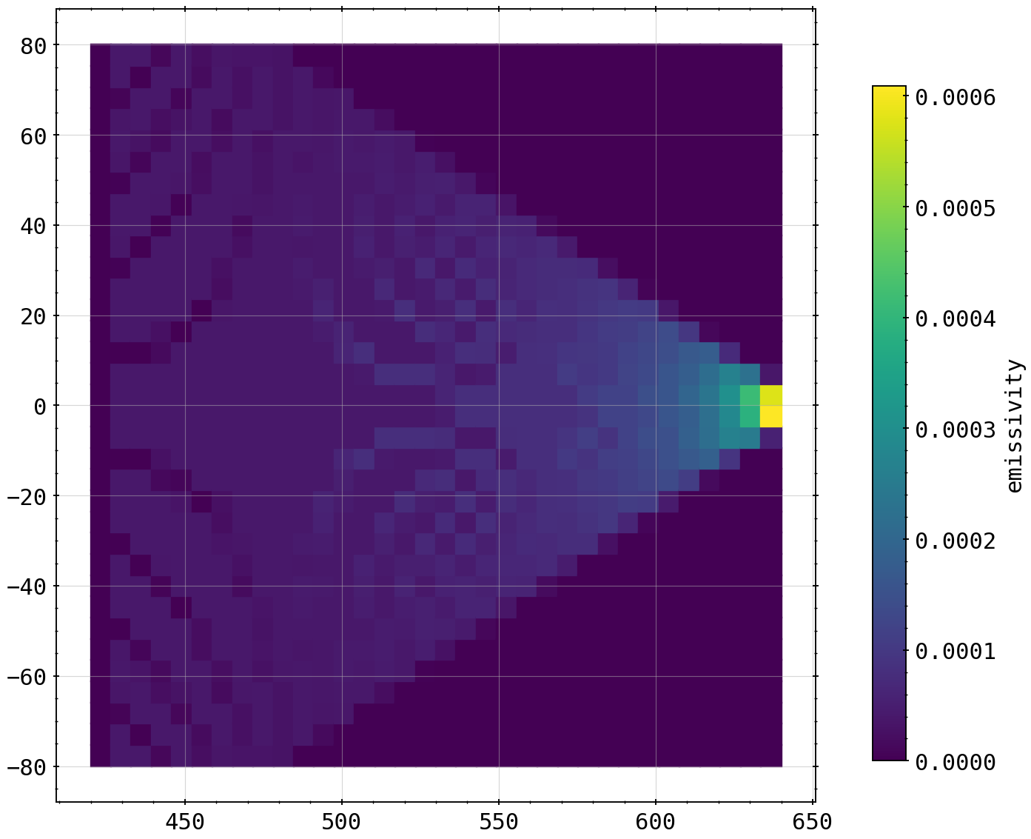
Cartesian Mesh and Test
using simple cartesian, i.e. rectangular mesh instead of fluxsurfaces and poloidal lines to calculate the geometry and tomogram
35x35
35x35

Slide 10
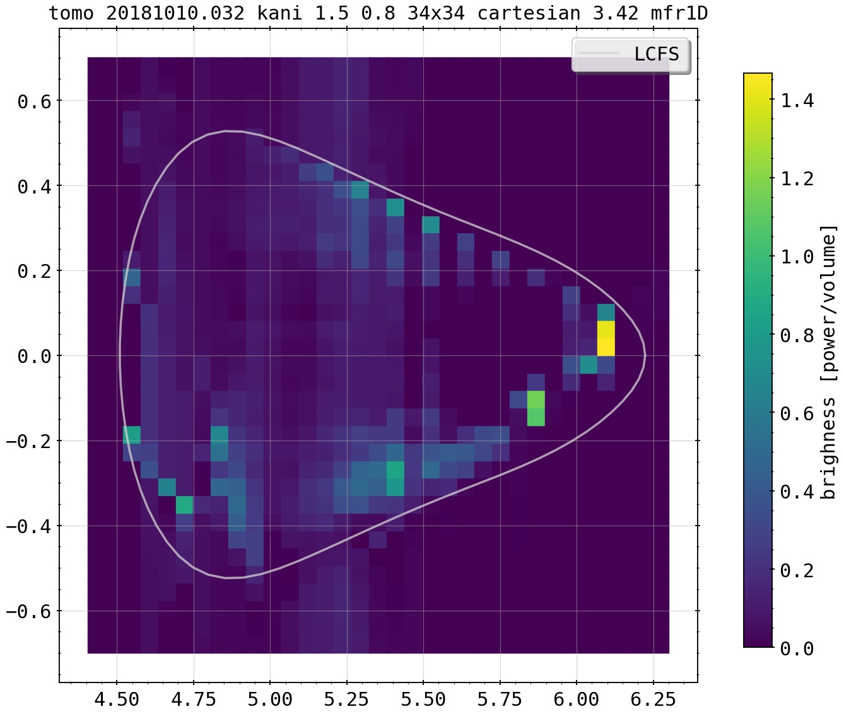
Cartesian Mesh and Test
using simple cartesian, i.e. rectangular mesh instead of fluxsurfaces and poloidal lines to calculate the geometry and tomogram
frad=100%
frad=100%

Slide 11
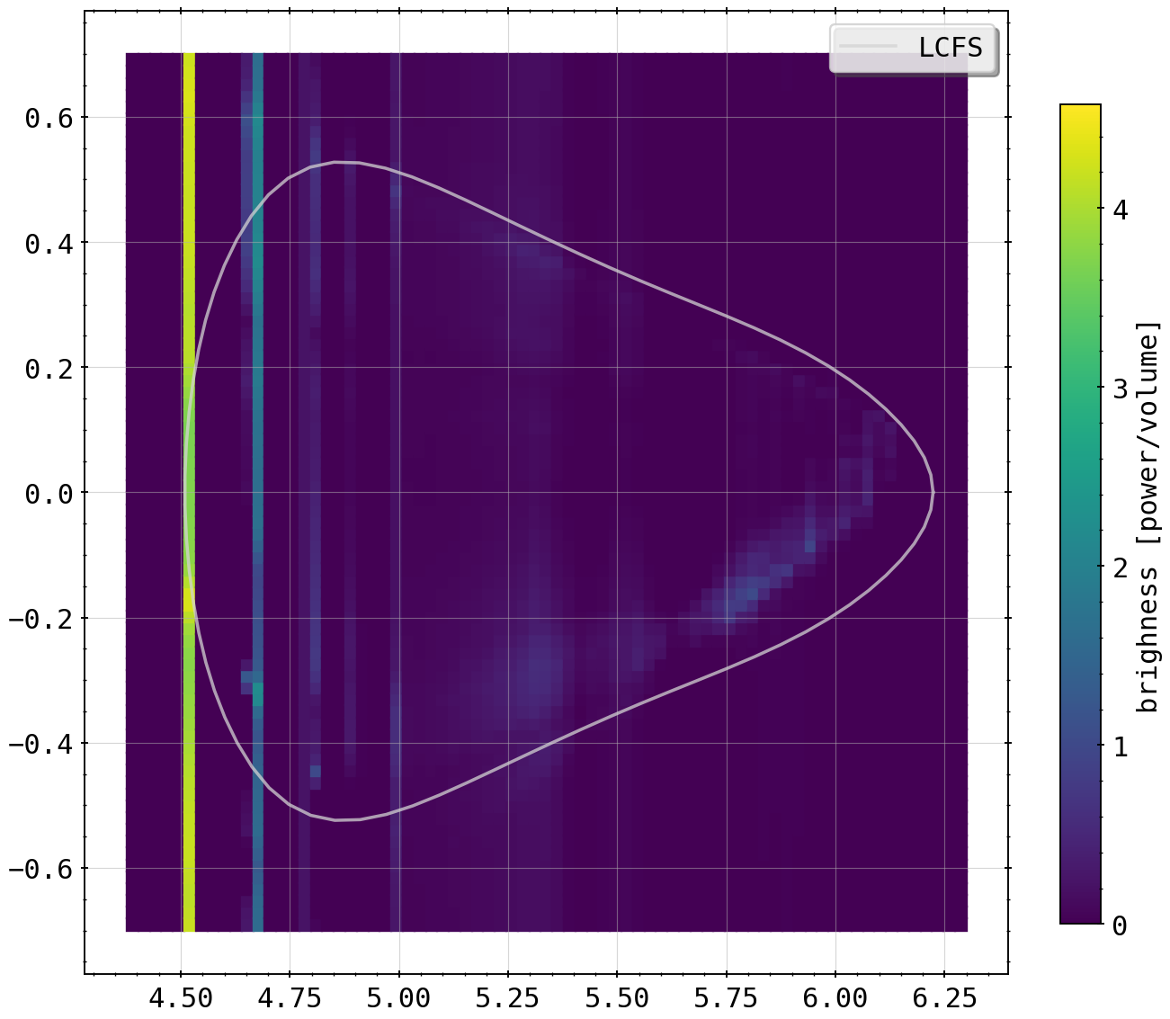
Cartesian Mesh and Test
using simple cartesian, i.e. rectangular mesh instead of fluxsurfaces and poloidal lines to calculate the geometry and tomogram
75x75
frad=100%
frad=100%

Slide 12
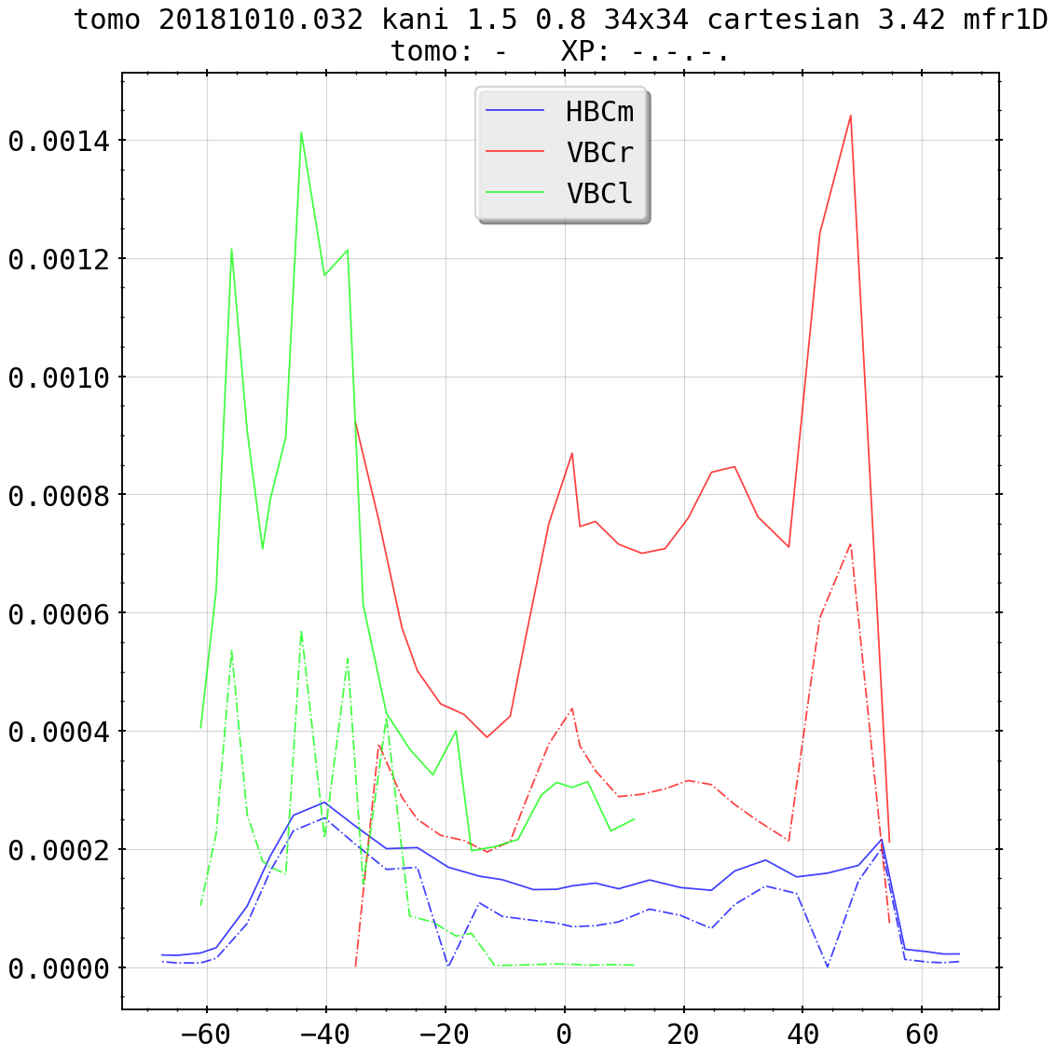
Cartesian Mesh and Test
using simple cartesian, i.e. rectangular mesh instead of fluxsurfaces and poloidal lines to calculate the geometry and tomogram
frad=100%
frad=100%

Slide 13
Cartesian Mesh and Test
using simple cartesian, i.e. rectangular mesh instead of fluxsurfaces and poloidal lines to calculate the geometry and tomogram
seems that cartesian grids work, but not as ‘good’ as those motivated by magnetic geometry and fluxsurfaces, though X²~1.0 for both
likely poloidal constraints suppress artifacts created due to lack of information, where only one camera/single channels yield radiation information

Slide 14
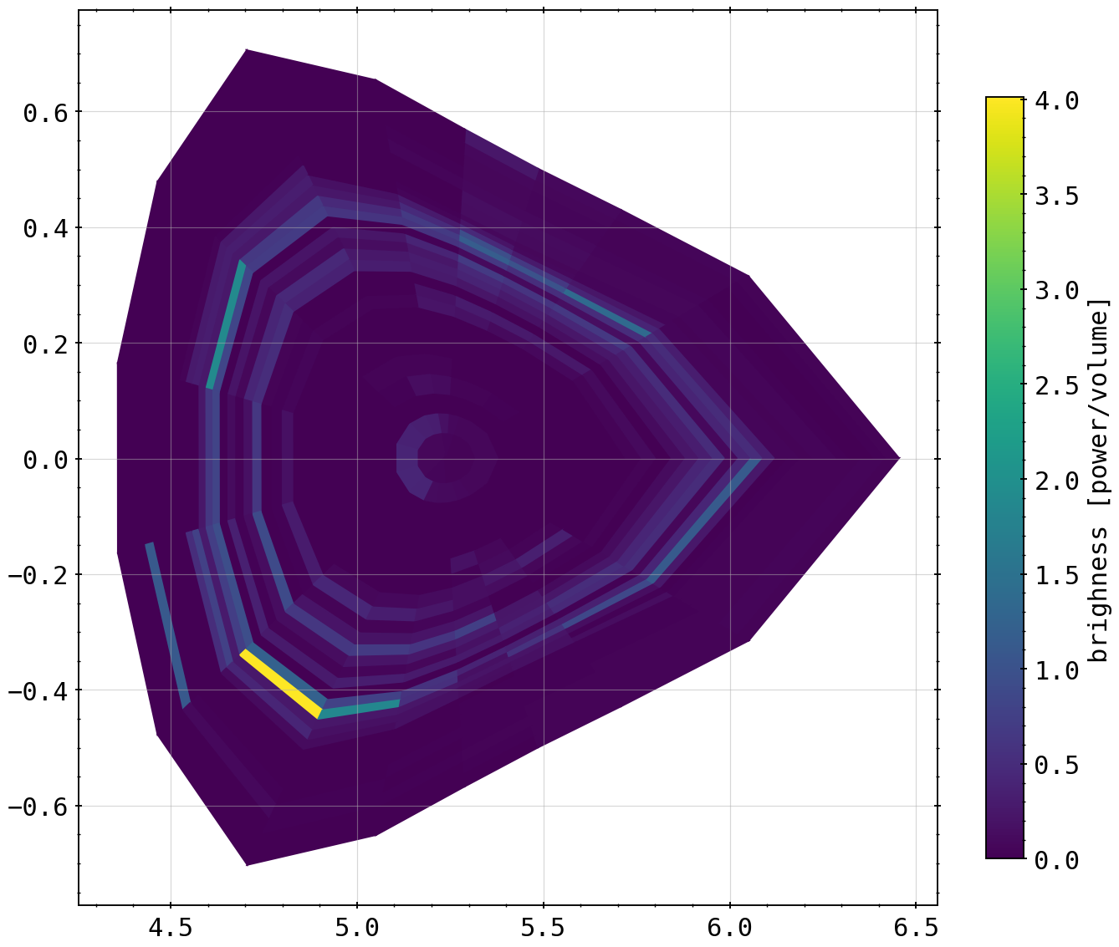
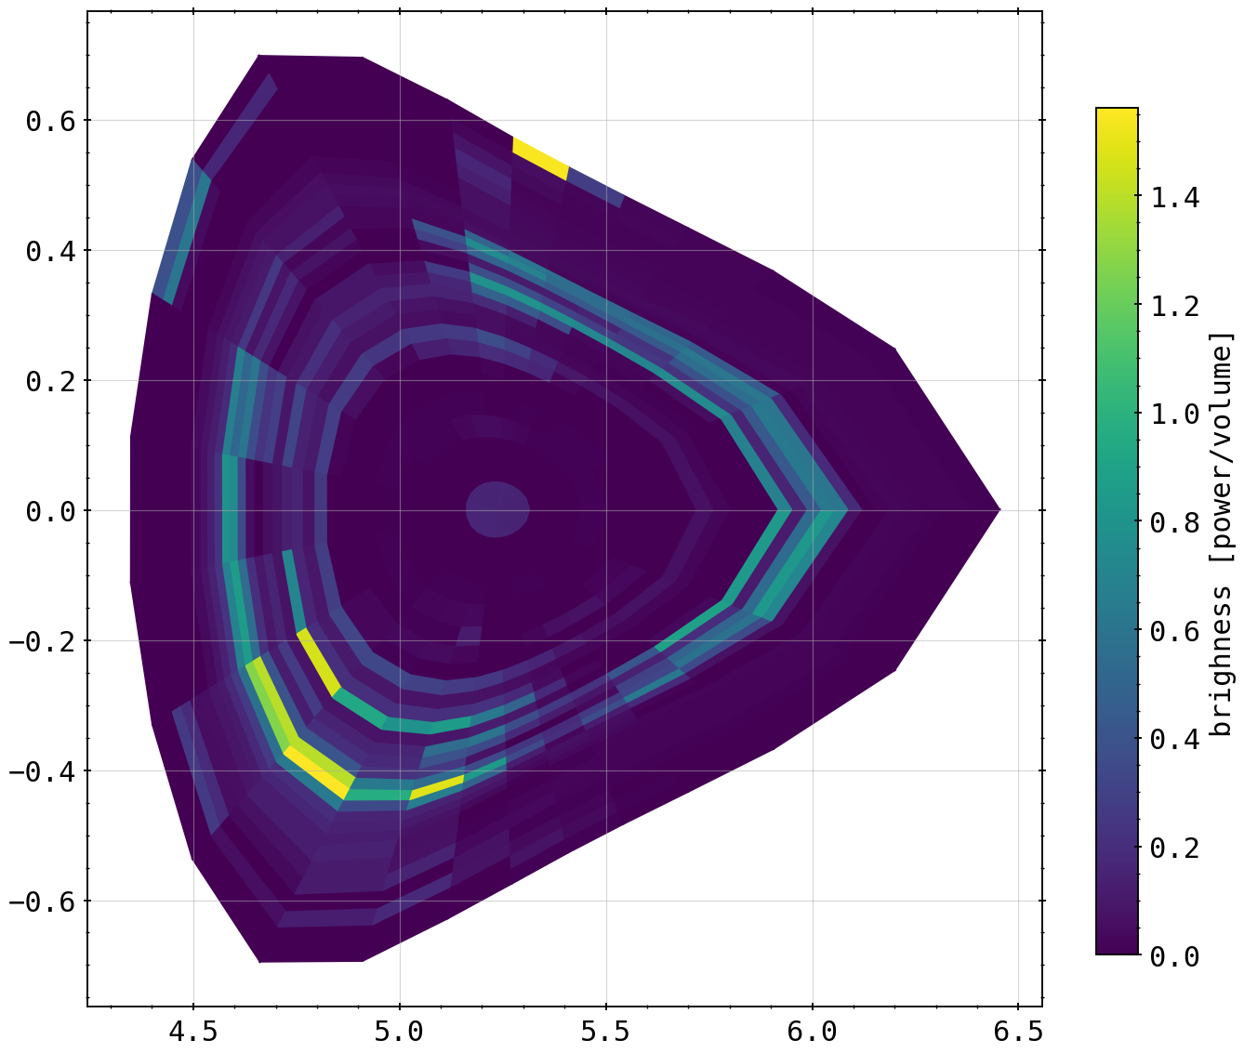
Mesh Test (kani_core = 1.5, k_diff = 0.8)
changing the mesh setup or geometry on same tomogram (frad=100%)
29x17
29x25

Slide 15
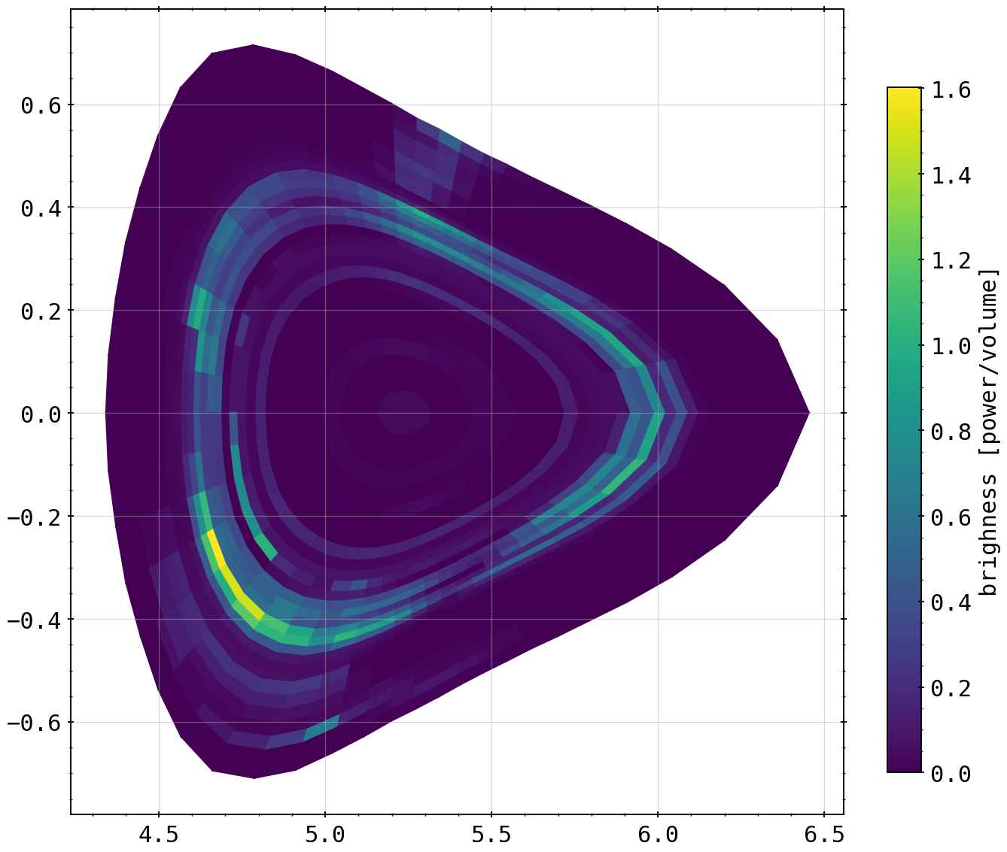
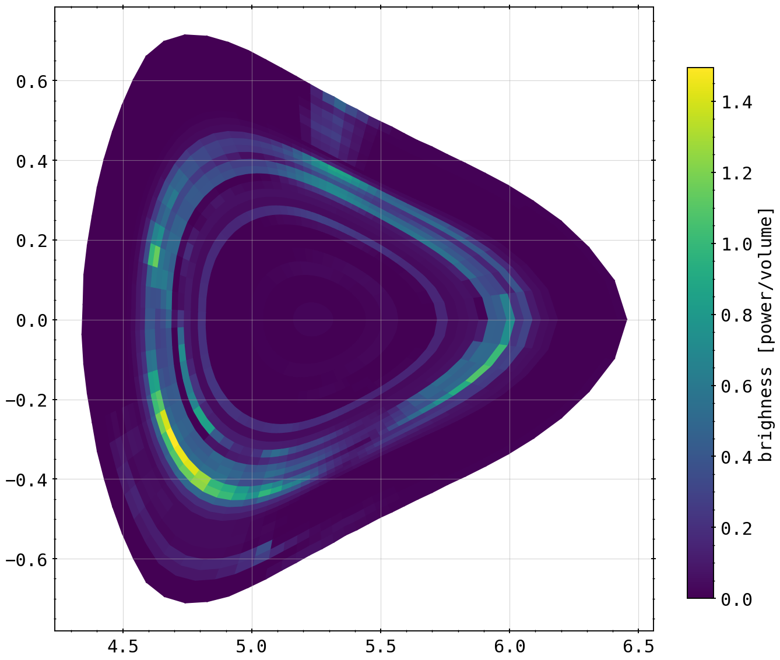
Mesh Test (kani_core = 1.5, k_diff = 0.8)
changing the mesh setup or geometry on same tomogram (frad=100%)
29x50
29x75

Slide 16
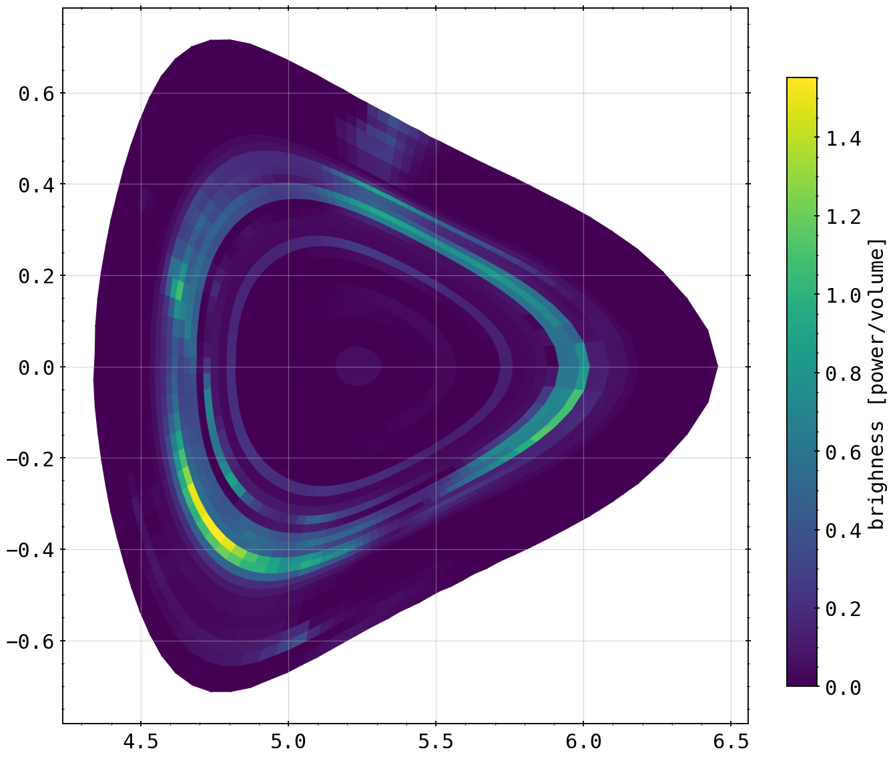
Mesh Test (kani_core = 1.5, k_diff = 0.8)
changing the mesh setup or geometry on same tomogram (frad=100%)
29x95

Slide 17

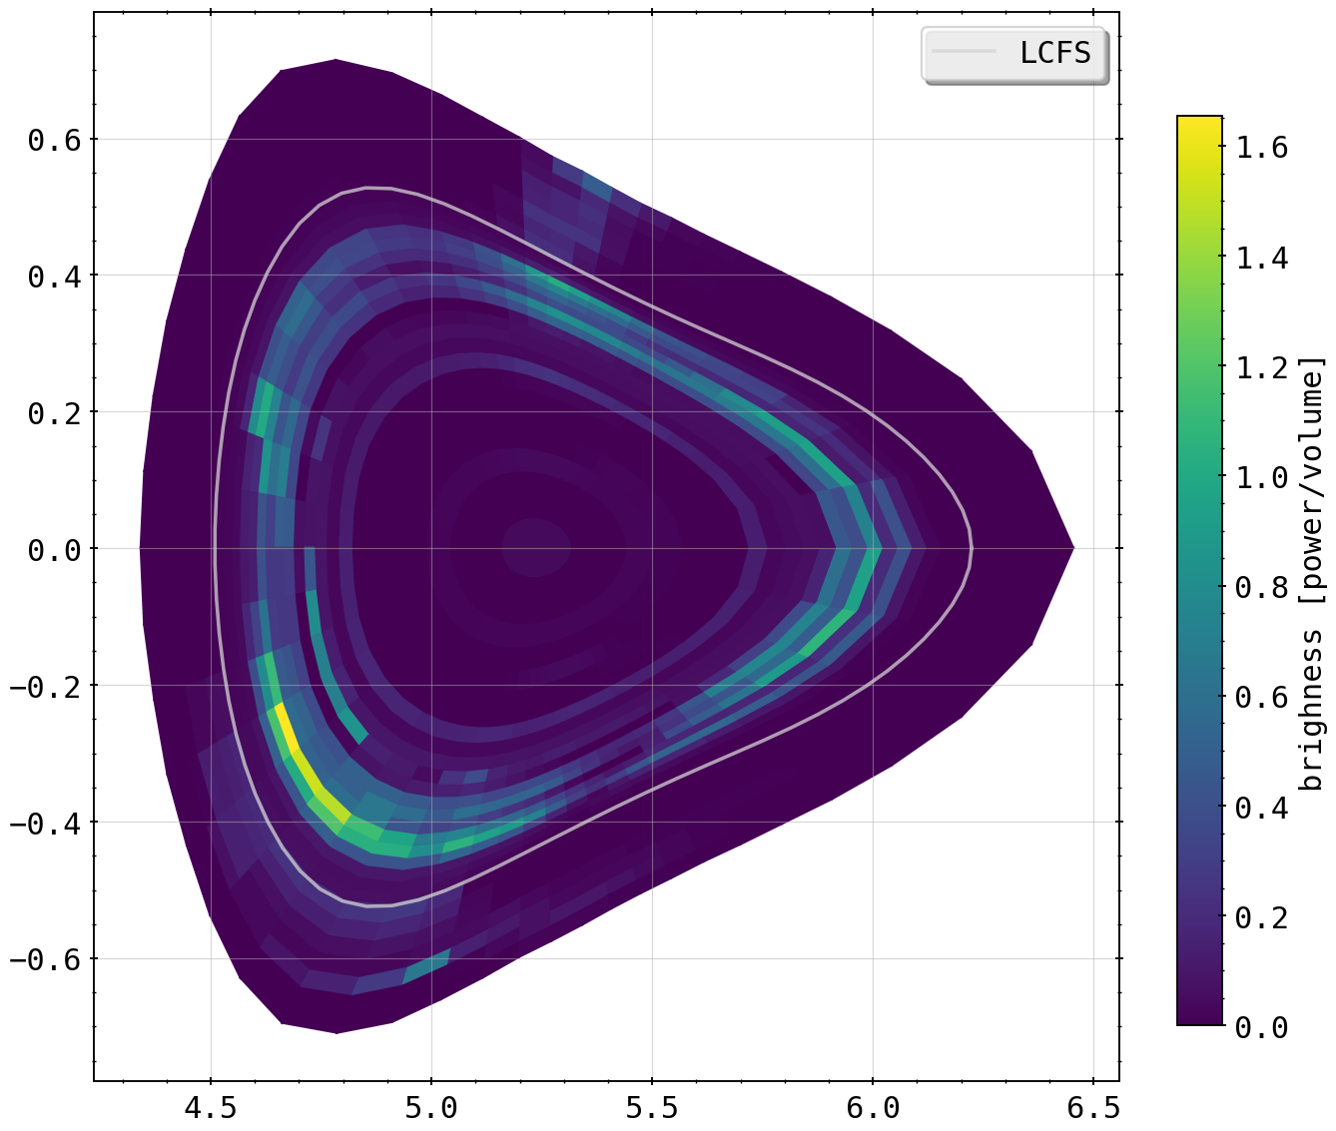
Mesh Test (kani_core = 1.5, k_diff = 0.8)
changing the mesh setup or geometry on same tomogram (frad=100%)
27x50
29x50

Slide 18
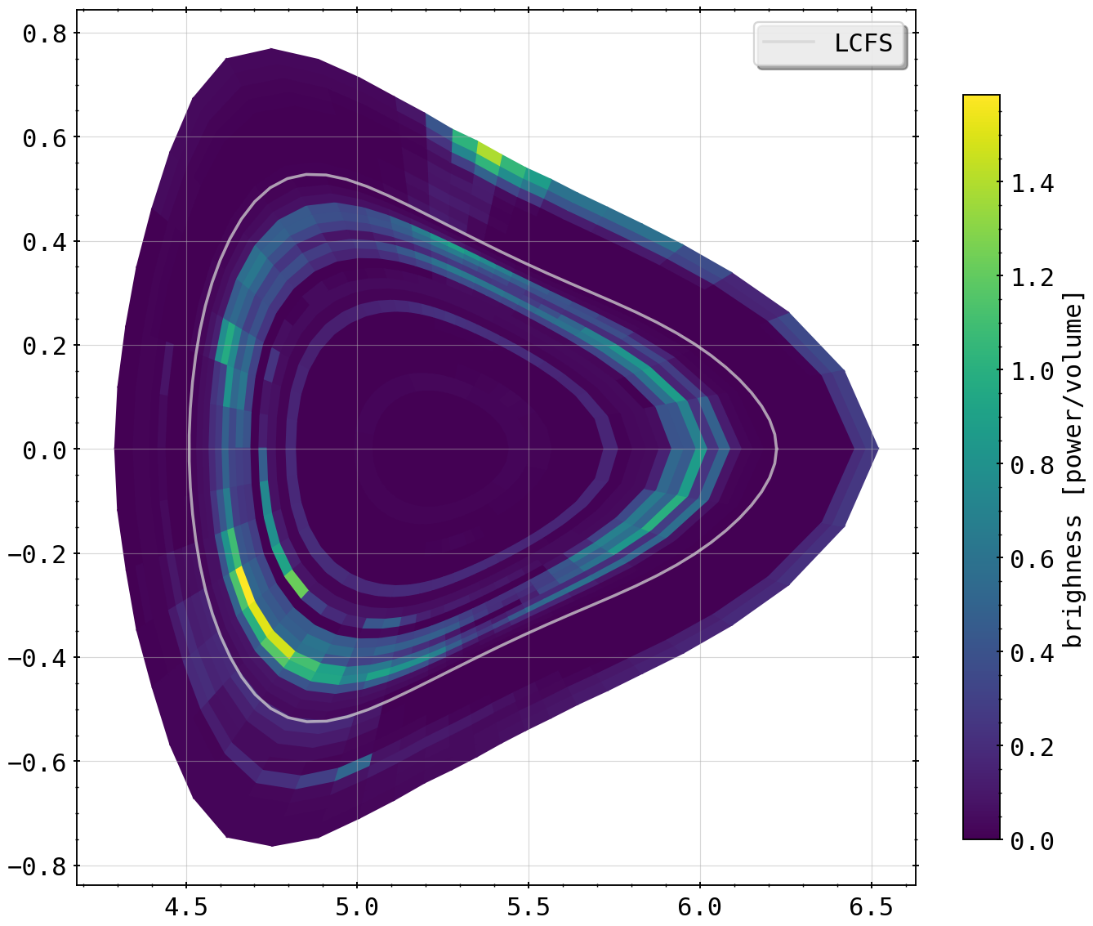
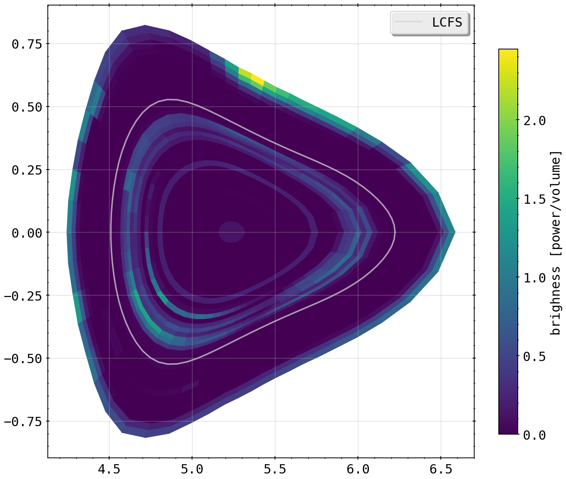
Mesh Test (kani_core = 1.5, k_diff = 0.8)
changing the mesh setup or geometry on same tomogram (frad=100%)
31x50
33x50

Slide 19
Mesh Test (kani_core = 1.5, k_diff = 0.8)
changing the mesh setup or geometry on same tomogram (frad=100%)
for same configuration, higher poloidal resolution might yield more information due to definition of gradient and smoothness constraint
infinitely more ‘lines’ however do not yield infinitely more quality, fall off at ~75 angular sections
increasing radial range can be detrimental to results of tomography, offering more degrees of freedom to regularization (as seen in results above)
artifacting is seen commonly for higher radial indices, compensating for the input profiles

Slide 20
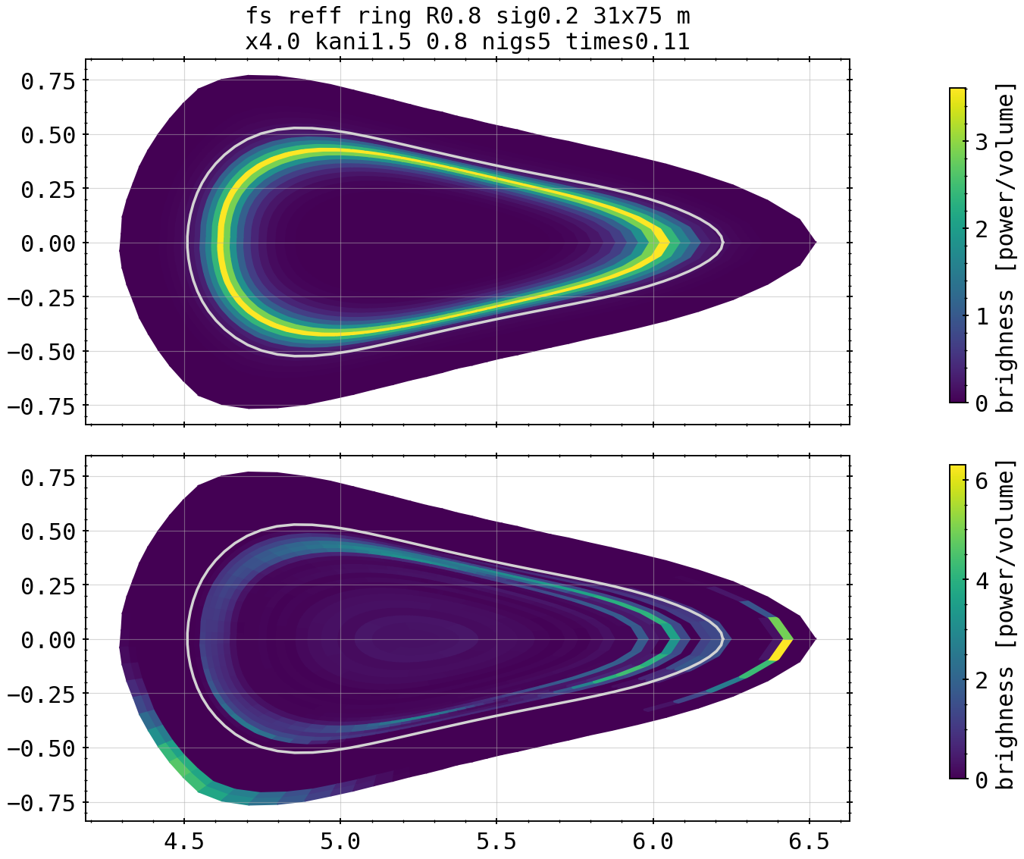
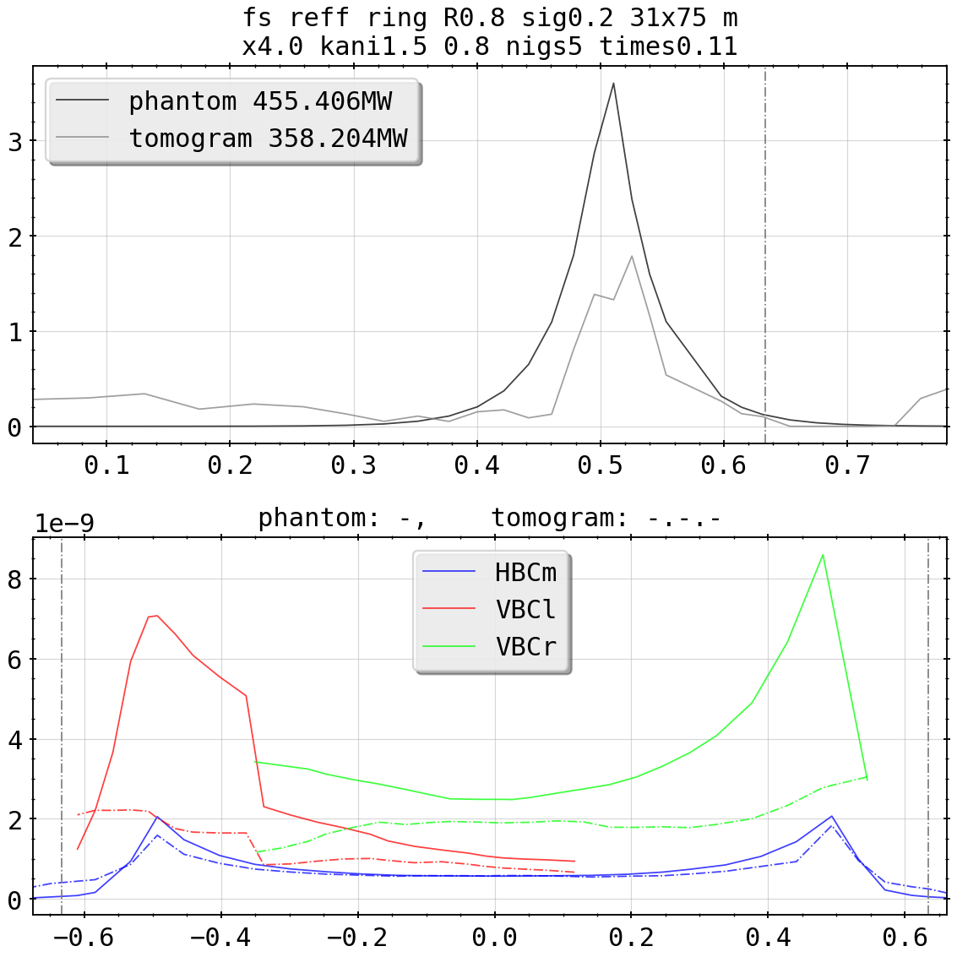
Phantom Tests: One Bright Ring (To Rule Them All)

Slide 21
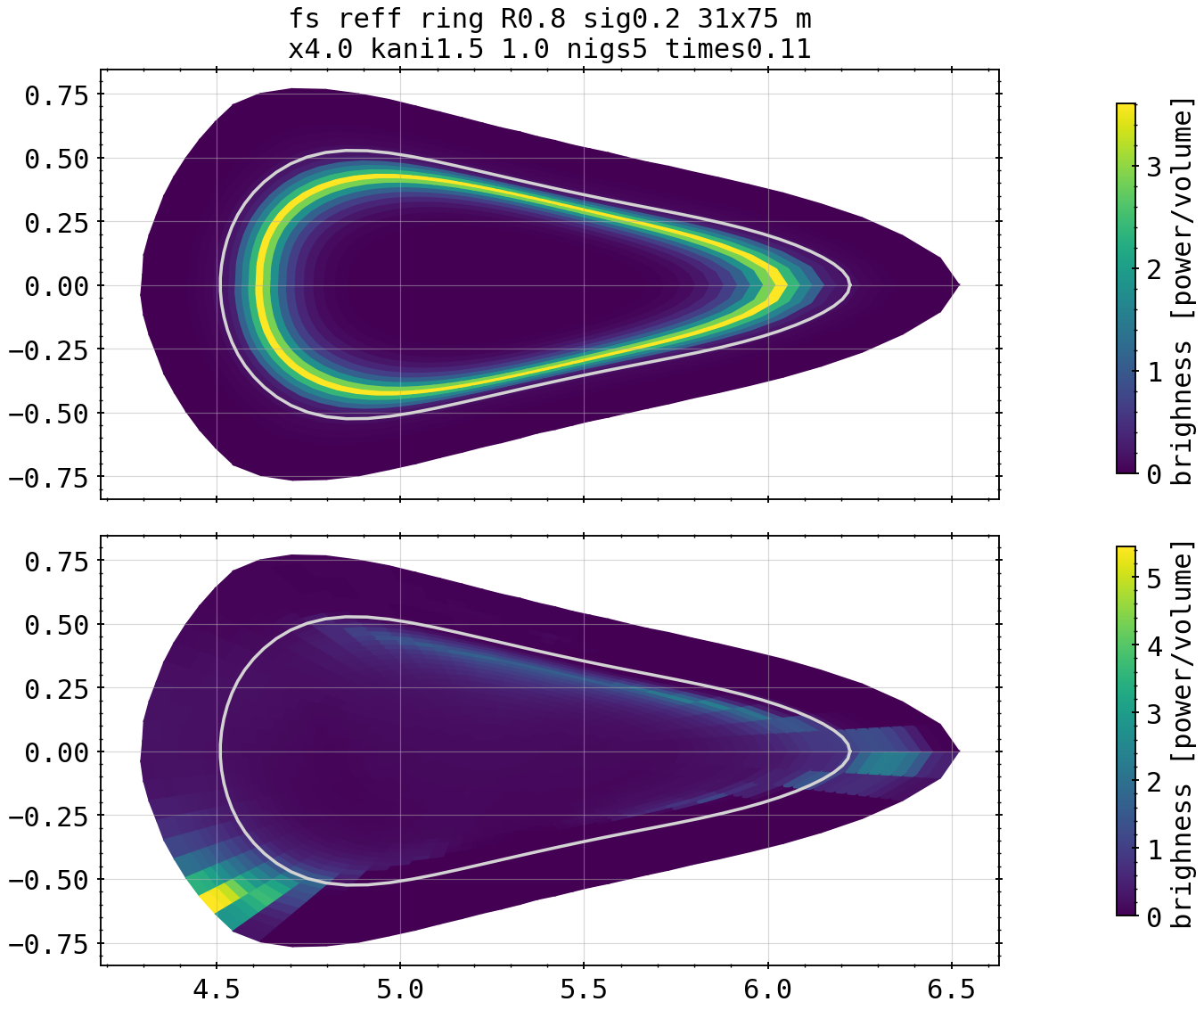
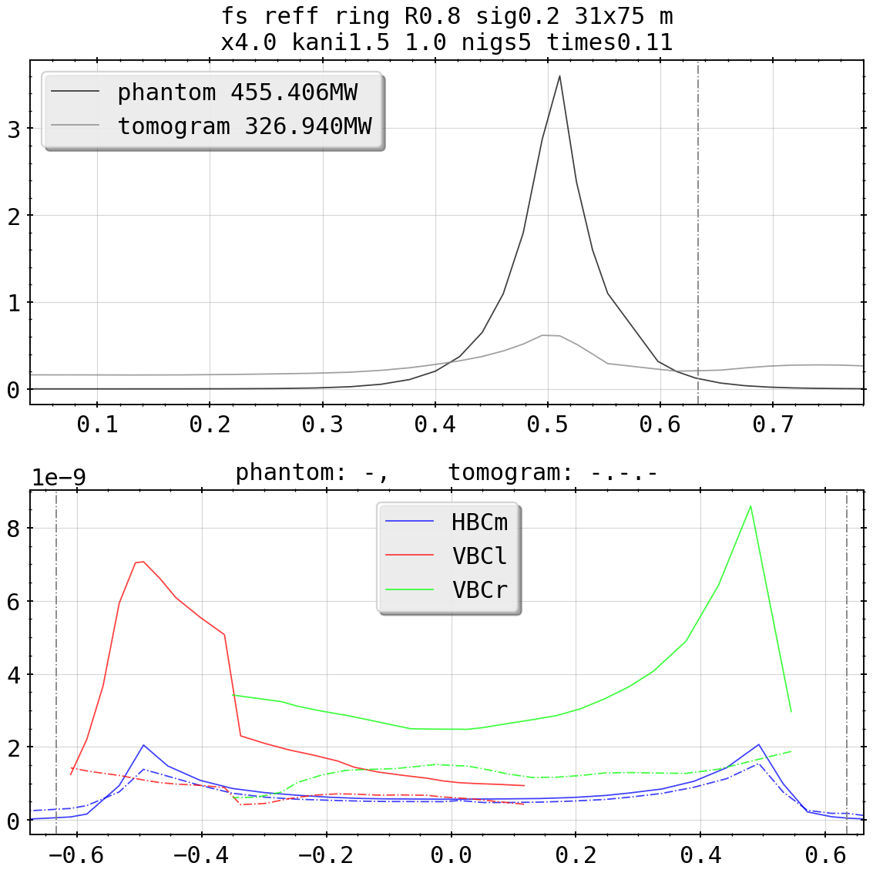
Phantom Tests: One Bright Ring (To Rule Them All)

Slide 22
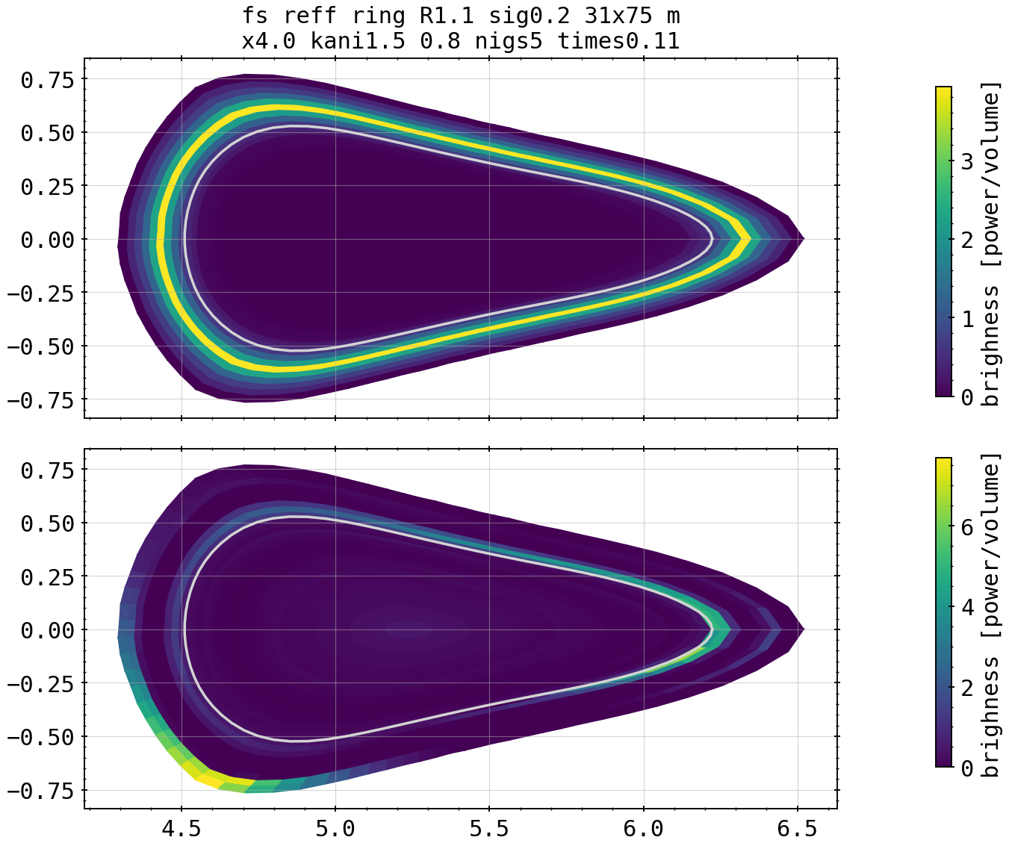
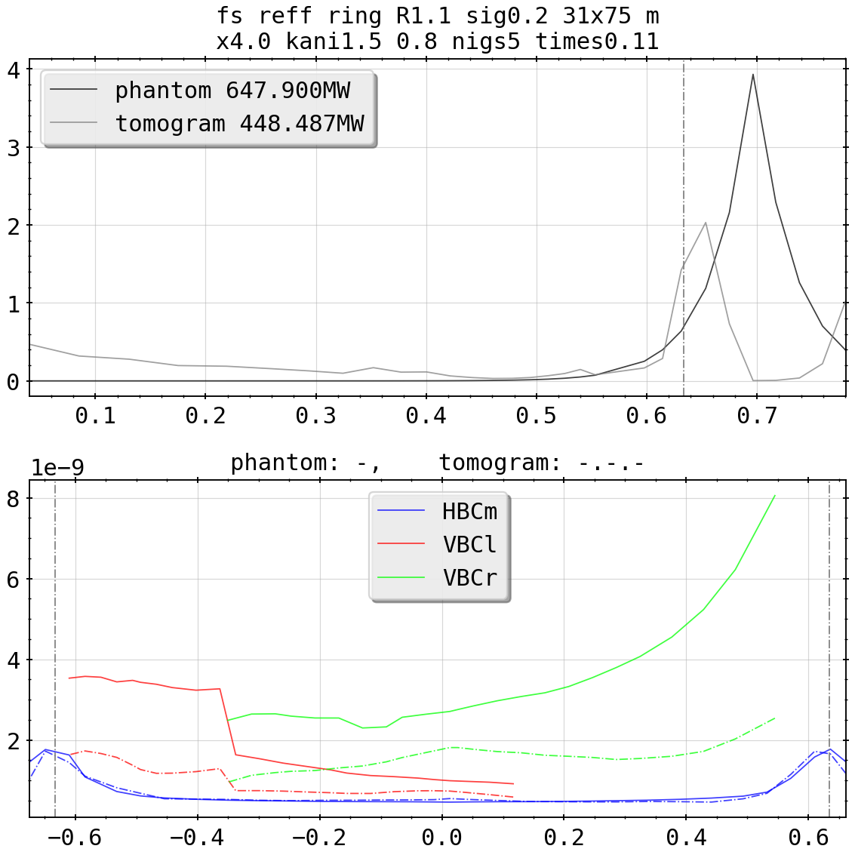
Phantom Tests: One Bright Ring (To Bind Them)

Slide 23
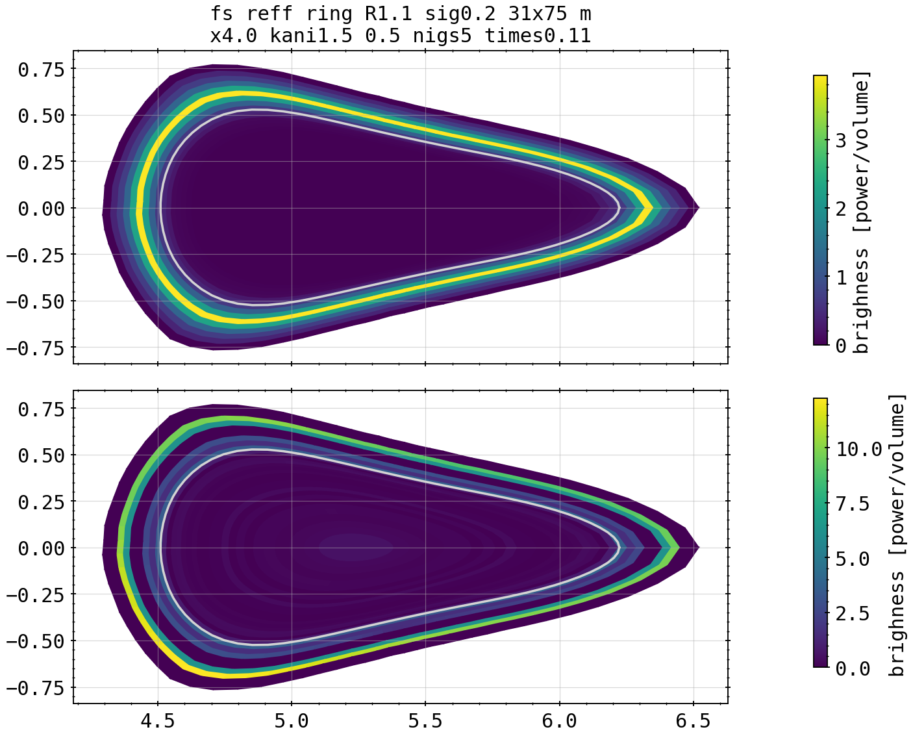
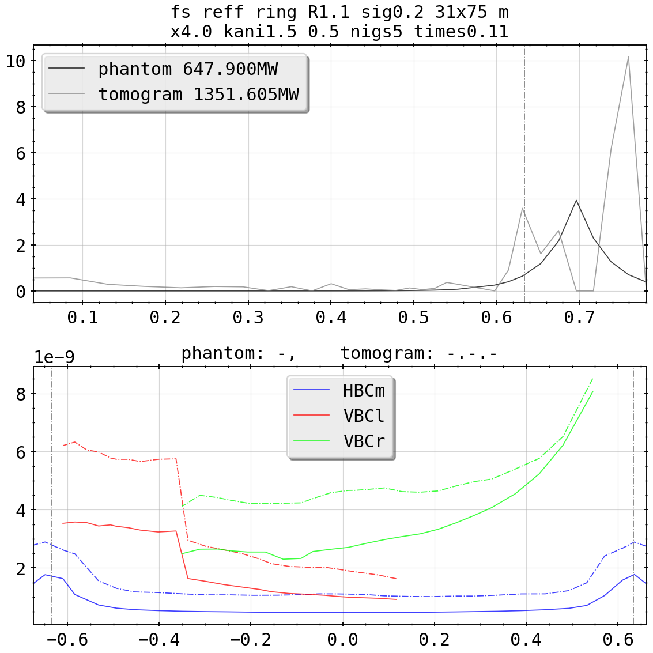
Phantom Tests: One Bright Ring (To Bind Them)

Slide 24
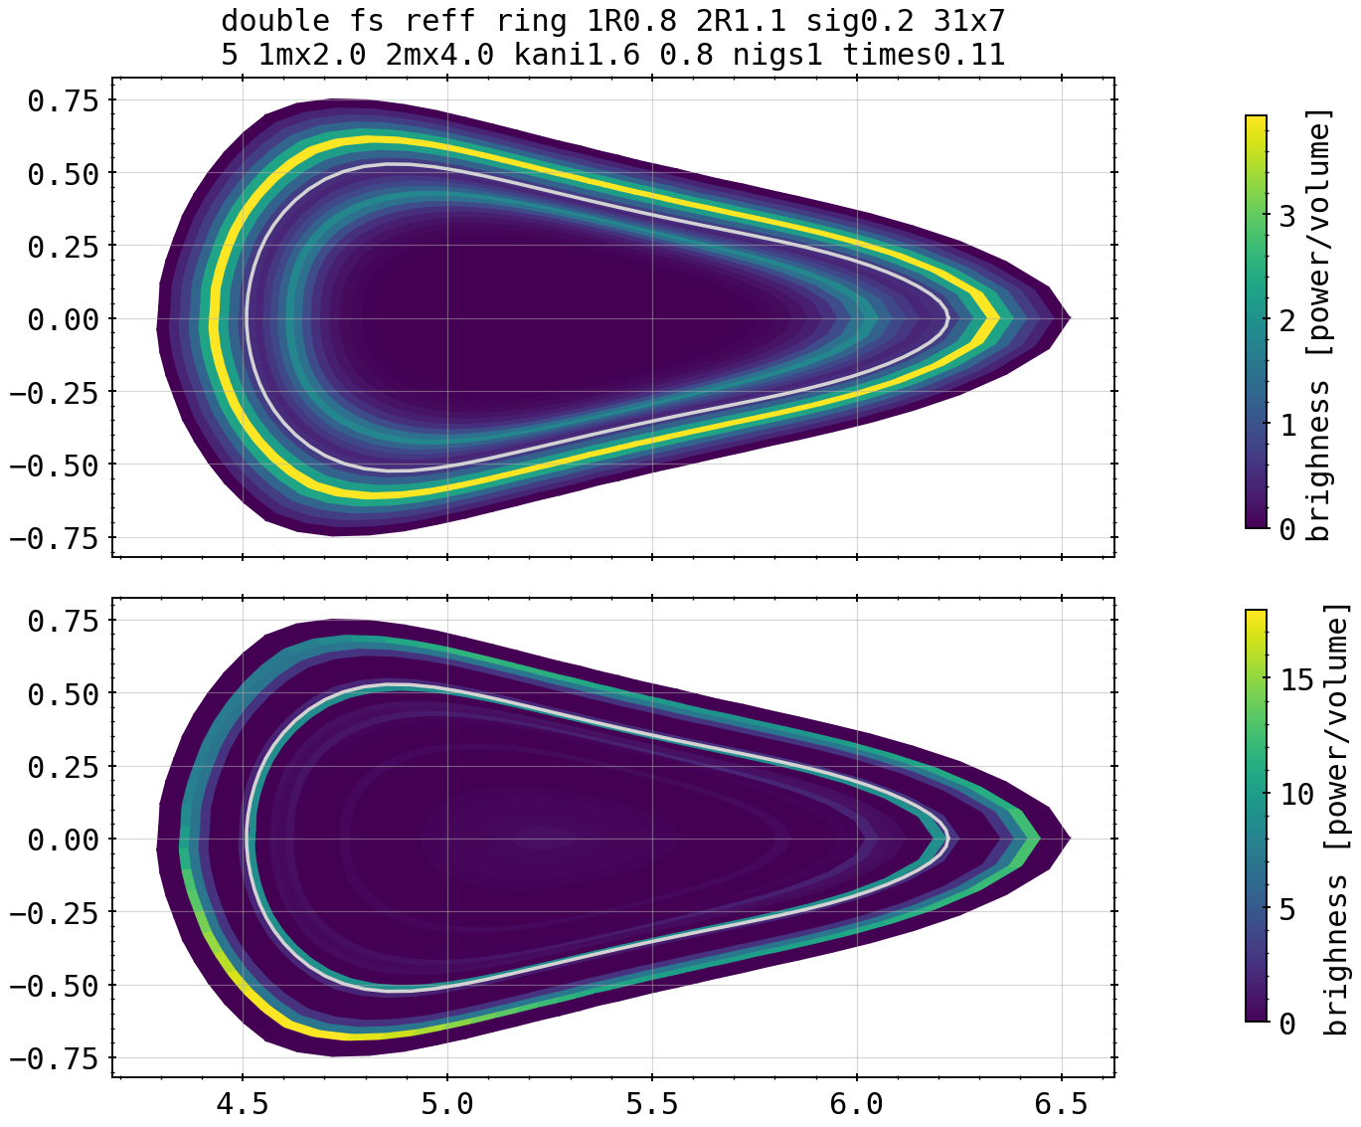
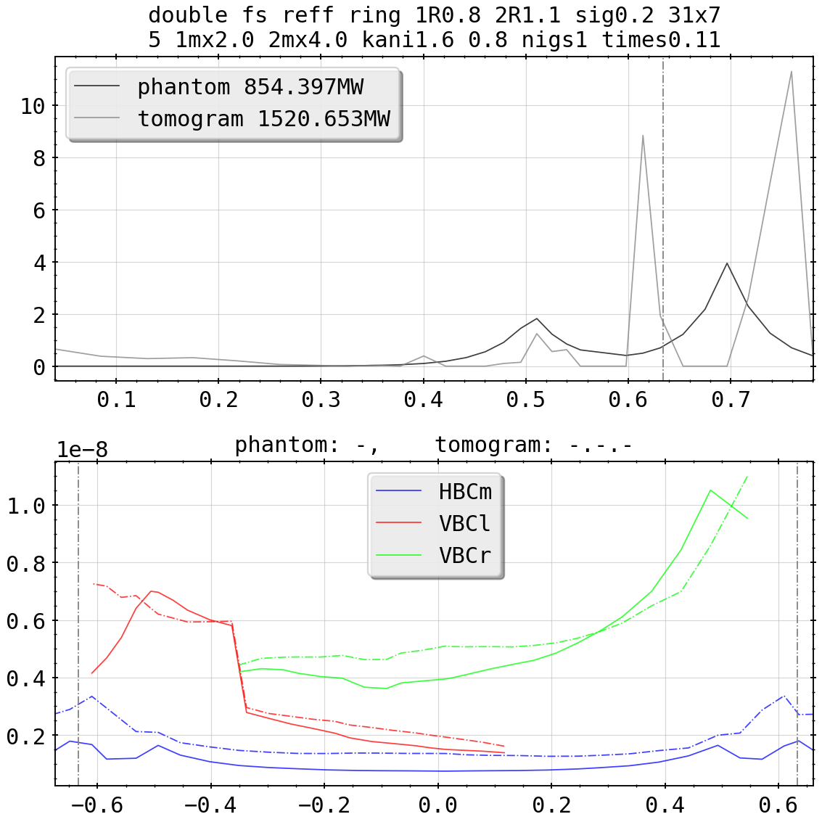
Phantom Tests: Two Bright Rings

Slide 25

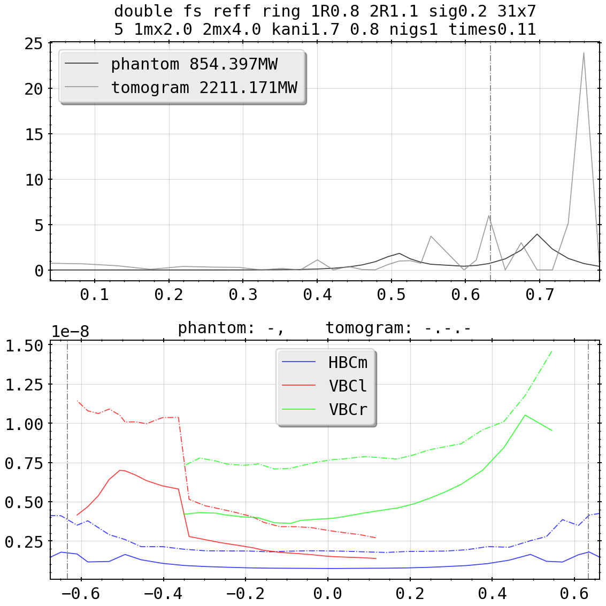
Phantom Tests: Two Bright Rings

Slide 26
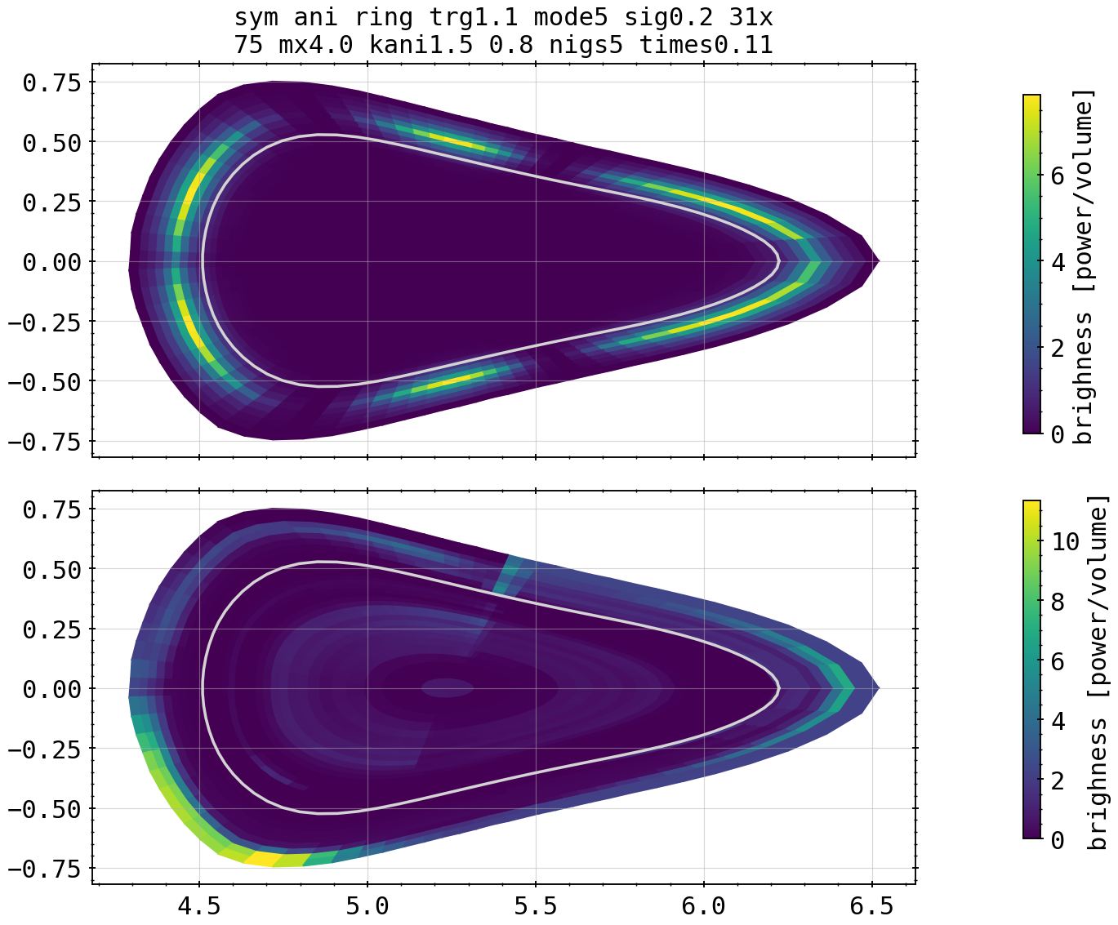
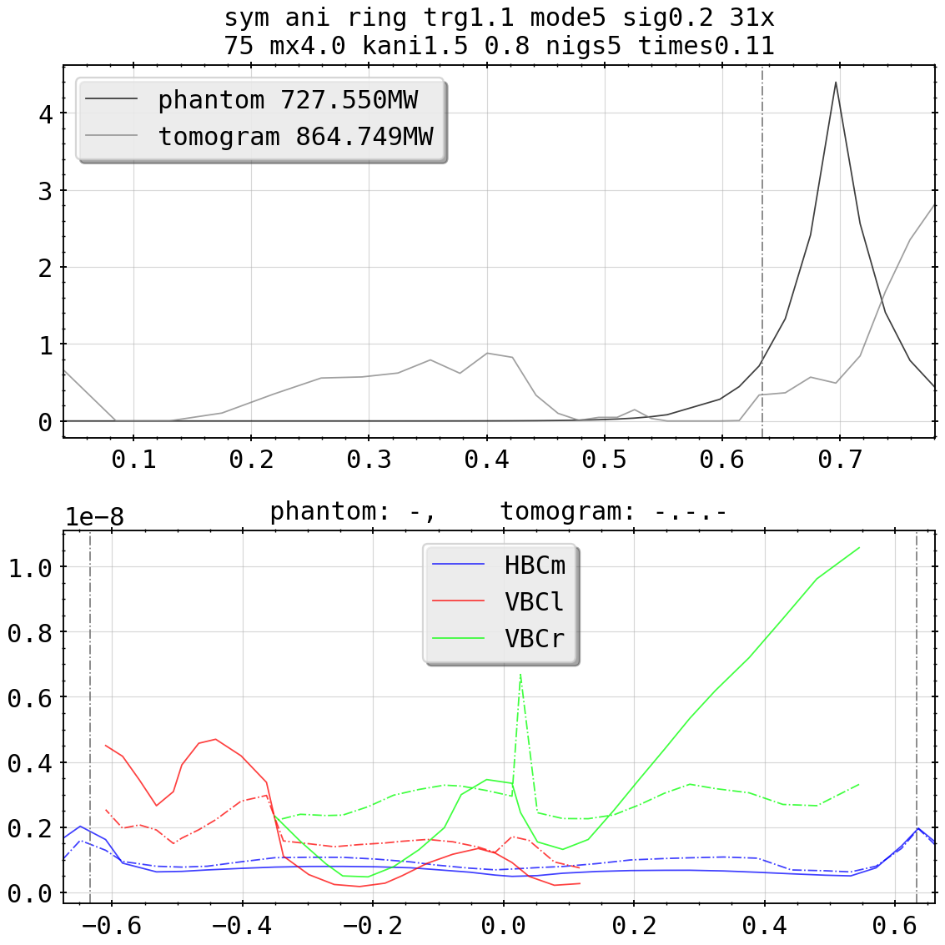
Phantom Tests: Anisotropic Island Mimics

Slide 27
Phantom Tests: Anisotropic Island Mimics
phantom tests yet incomplete, improving quality becomes multi-parameter optimization of input
tailoring of anisotropy factors to grid and/or phantom type likely necessary
consequently there might be a certain ‘best’ set of parameters from which a tomogram is calculated given a chordal profile of one/two/all cameras

Slide 28
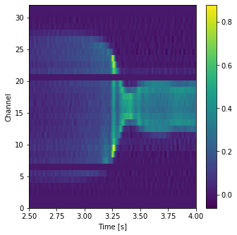
Requested Test of 20180725.044
reference KJM magnetic configuration used instead of standard EIM/EJM
20180725.044, chordal profile HBCm

Slide 29
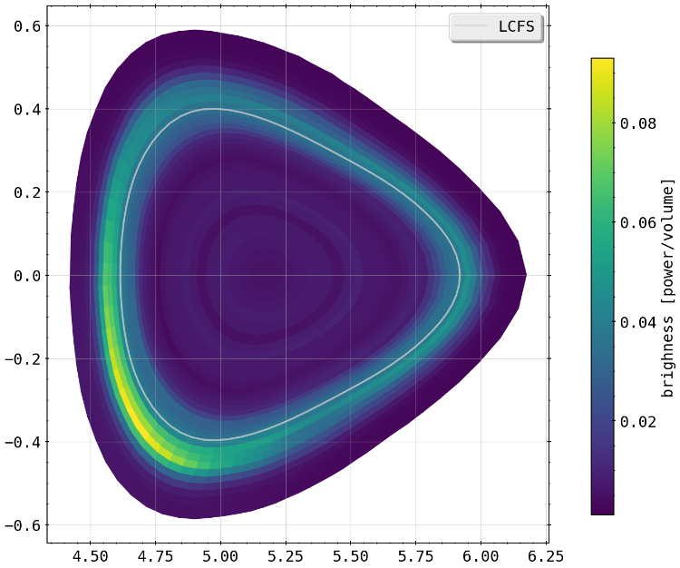
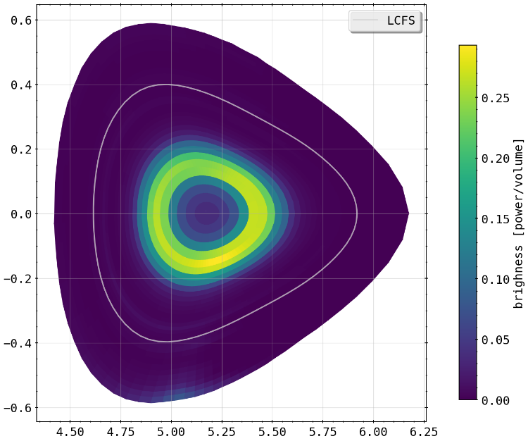
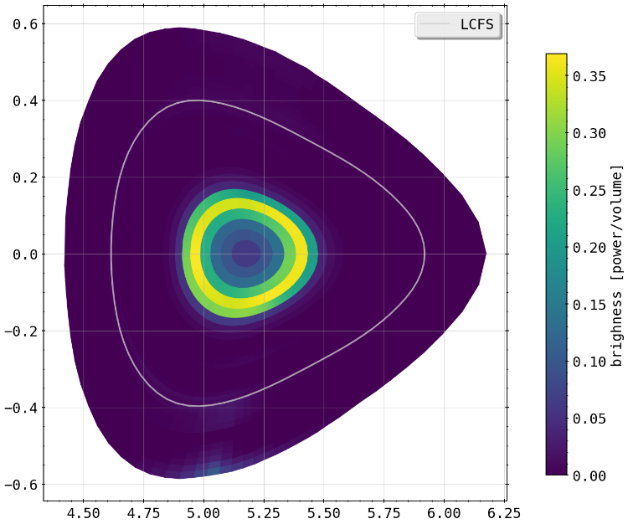
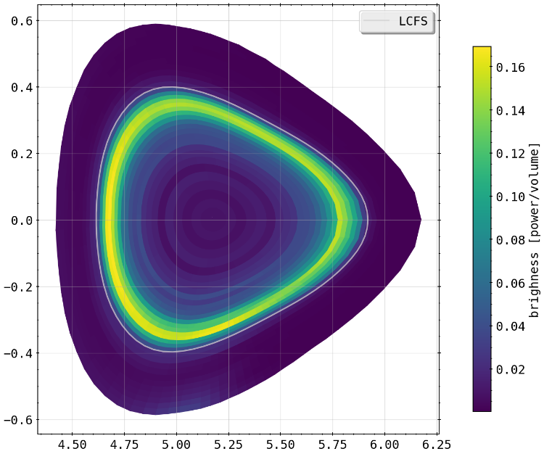
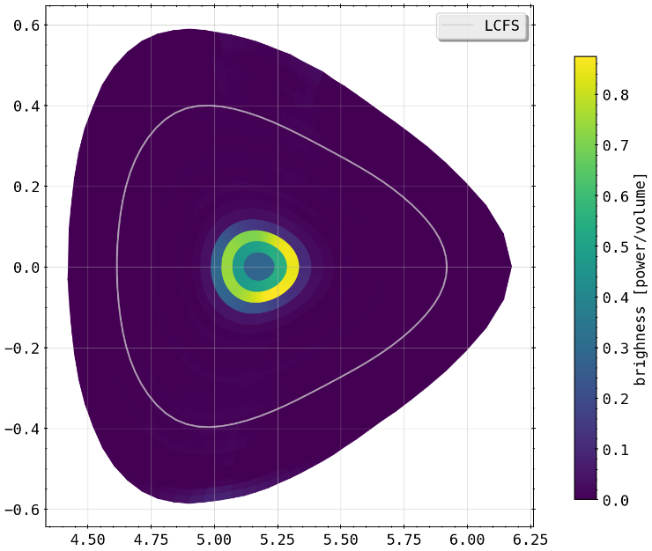
Requested Test of 20180725.044
reference KJM magnetic configuration used instead of standard EIM/EJM
3.3s
2.75s
3.6s
3.2s
3.4s

